Slide 1
INVENTORY MANAGEMENT SYSTEM ARRAYS FOR PRODUCT CATALOG, LINKED LIST FOR SOLD ITEMS HISTORY
PRESENTED BY
24KB1A05KA
24KB1A05DP
24KB1AO5CU
24KB1A05GA

Slide 2
OBJECTIVE
The primary objective of an Inventory Management System is to efficiently track, control, and manage inventory levels, ensuring that the right products are available at the right time, while minimizing costs and maximizing profitability.

Slide 3
INTRODUCTION
An Inventory Management System is a software application designed to help businesses and organizations efficiently track, manage, and control their stock of products or materials. It plays a crucial role in ensuring that the right amount of inventory is available at the right time, reducing both shortages and excess stock.
This system allows users to add new products, update stock quantities, process sales, and monitor inventory levels in real time. By automating these tasks, it minimizes manual errors, saves time, and provides accurate records that can be used for analysis and decision-making.
Whether in retail, manufacturing, or services, an inventory management system is essential for improving operational efficiency, maintaining customer satisfaction, and supporting business growt

Slide 4
Data Structures Overview
Array
Structure
Simulated Linked List
Arrays are used to store products in the format Product products[MAX_PRODUCTS]. This provides indexed storage with a fixed size, enabling efficient access to product information.
Structures are defined for both Product and Sale entities. The Product structure includes fields for id, name, quantity, and price, while the Sale structure includes product_id, quantity sold, and total price.
Sales data is stored sequentially in the sales[] array. Index-based traversal simulates linked list-style behavior, allowing for efficient management of sales records.
Sequential storage in array
Indexed storage
Product: id, name, quantity, price
Index-based traversal
Fixed size allocation
Sale: product_id, quantity sold, total price

Slide 5
Why use an array for the product catalog? 1. Fixed and predictable size: The number of products is usually known to be limited (e.g., under 100), so a static array works well. 2. Fast access by index: Arrays allow O(1) time access, making it easy to search or update a product by index. 3. No frequent insertions/deletions: The product list doesn’t change often. You typically just add products occasionally. Arrays are efficient when you don’t need to insert/delete in the middle. 4. Simplicity: Arrays are easier to implement and debug, especially in C.

Slide 6
Why prefer a linked list for sales history? 1.Dynamic size: Sales are made continuously, so a linked list avoids the need to predefine MAX_SALES. 2.Frequent additions: Linked lists are efficient for appending new records at runtime. 3.Unbounded growth: You may want to keep sales history indefinitely (or save to a file), so dynamic memory is more appropriate. 4.Rare lookups: Unlike products, you usually just display recent sales — so sequential access is fine.

Slide 7
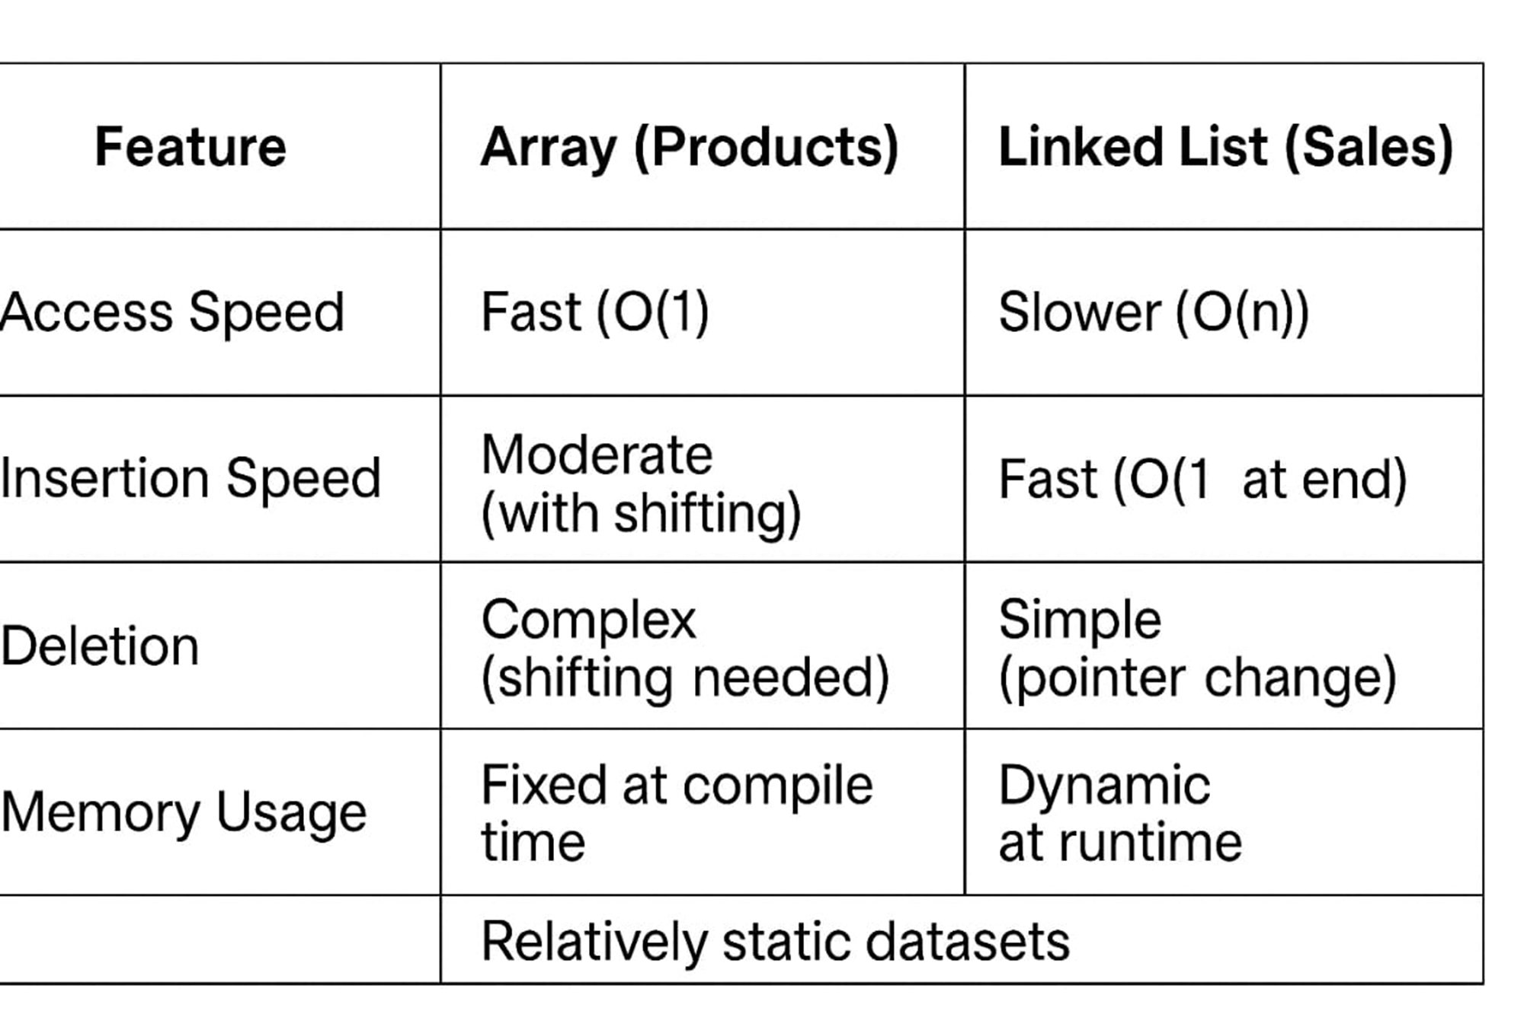

Slide 8

System Functionalities
1
Add Product
The system collects product details, such as name, quantity, and price, and stores this information in the product array. This ensures all products are tracked for inventory purposes.
2
List Products
The system displays all available products, showing key details like product ID, name, quantity, and price, providing a clear overview of the current inventory.
3
Sell Product
Upon a sale, the system updates the quantity of the product and records the sale in the sales array, tracking product movement and sales history.
4
View Sales
The system displays a list of sold items with the total price, allowing users to review sales records and analyze sales performance.

Slide 9
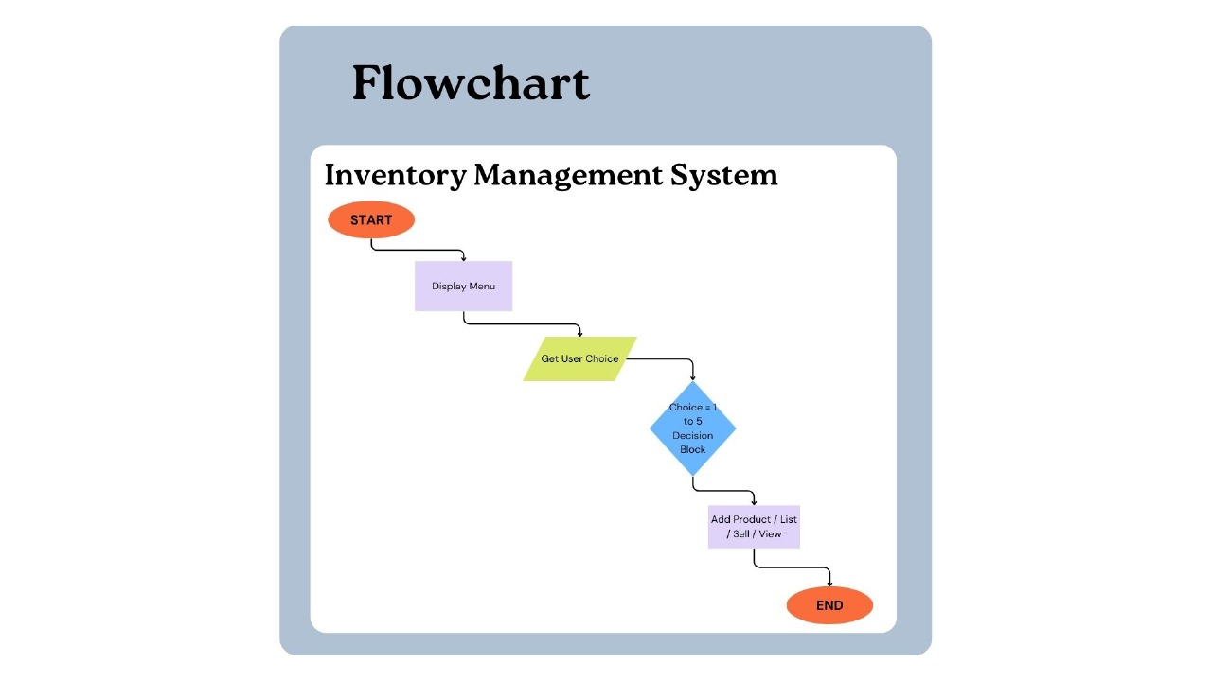
System Flowchart

Slide 10

Code Snapshot: Product Handling
Product Structure
addProduct()
struct Product {
int id;
char name[50];
int quantity;
float price;
};
void addProduct() {
// Code to collect product details
// and store in product array
}
listProducts()
void listProducts() {
// Code to display all available
// products in the system
}
The code includes the structure of the Product and sample functions for adding and listing products. The highlights include ID-based product search and input validation for product count, ensuring data integrity.

Slide 11

Code Snapshot: Sales Handling
Sale Structure
sellProduct()
struct Sale {
int product_id;
int quantity_sold;
float total_price;
};
void sellProduct() {
// Code to update quantity after sale
// and record sale in sales array
}
listSales()
void listSales() {
// Code to display list of sold
// items with total price
}
The sales handling code includes the structure of the Sale and sample functions for selling products and listing sales. Key features include quantity check before sale, sale record creation, and sales listed with total value, ensuring accurate sales tracking.

Slide 12
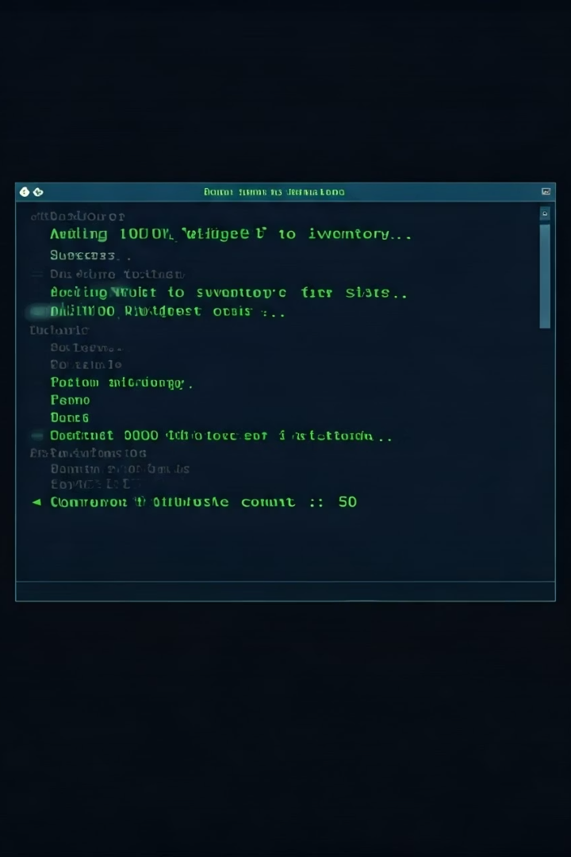
Sample Test Case & Output
Adding Products:
Apple (ID: 101, Qty: 50, Price: 2.5)
Banana (ID: 102, Qty: 100, Price: 1.0)
Selling:
Apple ×10 → ₹25.00
Output:
ID Name Qty Price
101 Apple 40 2.50
102 Banana 100 1.00
Sales: Product ID Qty Total Price
101 10 25.00
The test case demonstrates adding products such as Apple and Banana, selling a quantity of Apple, and displaying the output showing updated inventory and sales records. This showcases the system's functionality and data accuracy.

Slide 13
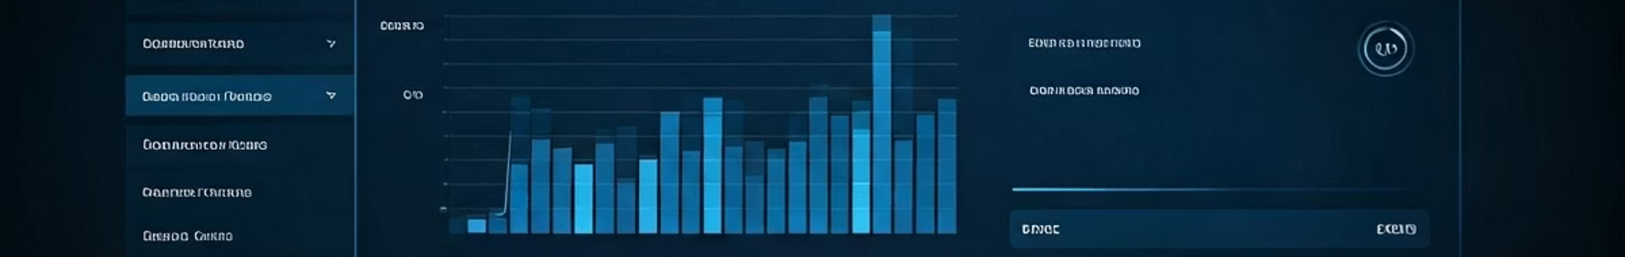
Conclusion & Future Scope
Additional Features
Future Scope
Implement search, update, and delete features to improve data management and system functionality.
Achievements
Enhancements include using file handling for persistent storage, dynamic memory with linked lists, and a GUI for better usability.
Basic inventory system built with arrays and structures provides a functional command-line interface for managing products and sales.
The inventory system has achieved its goal of providing a basic, functional command-line interface. Future developments could focus on implementing file handling for persistent storage, dynamic memory with linked lists, a GUI for better usability, and additional features such as search, update, and delete.

Slide 14
THANK YOU

